Slide 1
Week 7
Peer Assisted Learning

Slide 2
Today
Threads in Java
Value Iteration Algorithm
Time to work on coursework together and ask questions.

Slide 3
Threads in Java
In your lecture last week, you covered:
Forking in C
Threads in Java via
Extending the Thread class
Implementing the Runnable interface
Having an inner class, inheriting from Thread

Slide 4
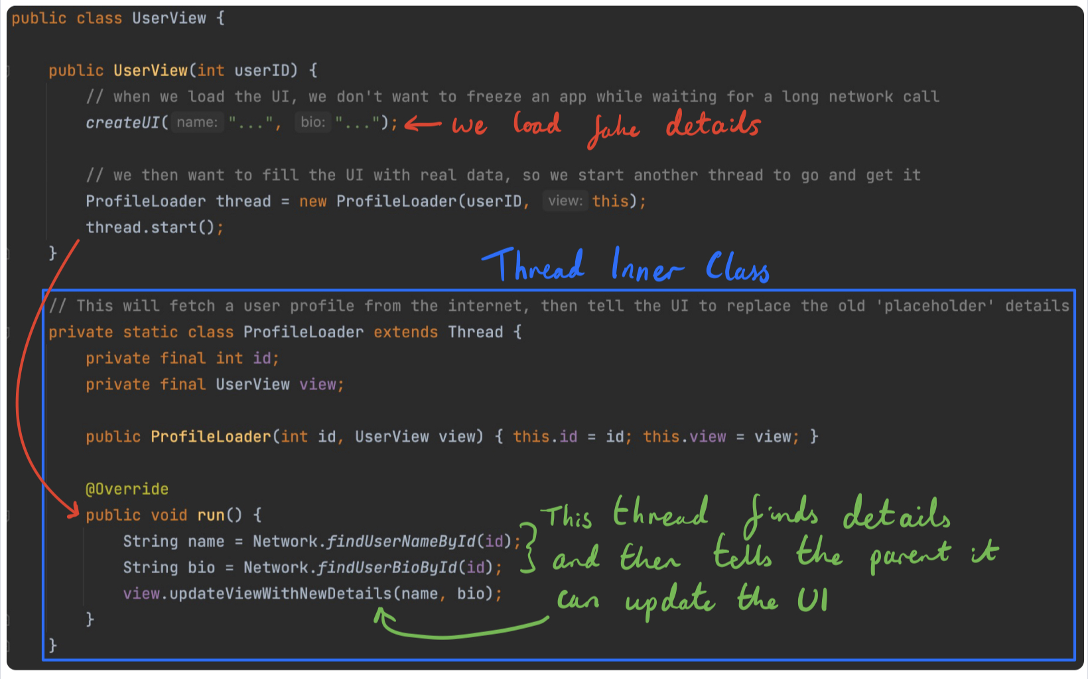
The Inner Class
The best method to handle threads

Slide 5
The Thread Class
The Thread class can take in a function and use that for the ‘run()’ method automatically
You do not need to know how this works, or why this works, but if you are interested, Functional Programming in Year 2 will cover it
You just need a function/method that has no parameters, and doesn’t return anything

Slide 6
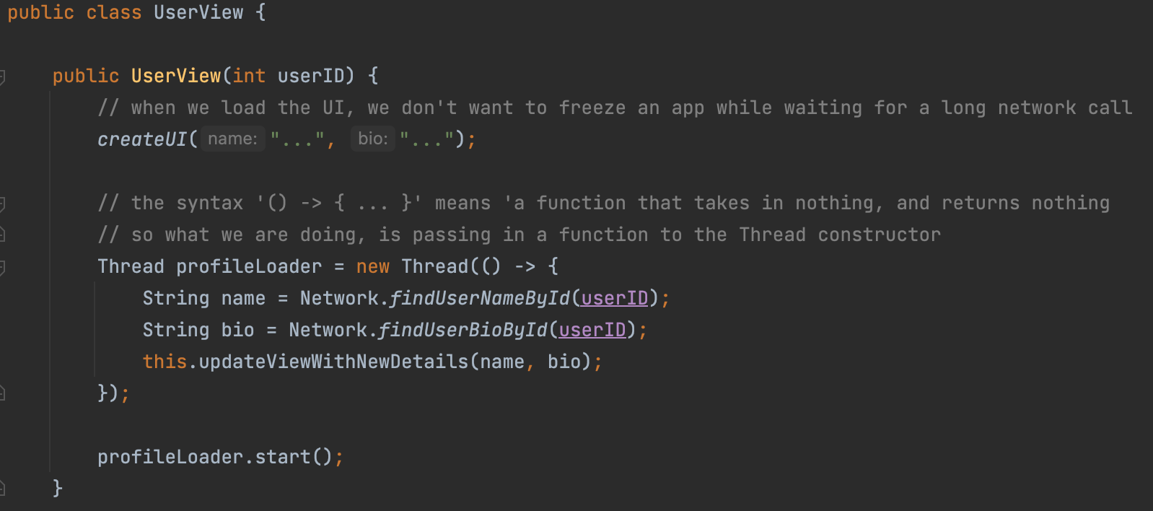
Threads for Dummies Professionals
The Thread constructor can take in a function, which we can declare using: () -> {
CODE GOES HERE
}

Slide 7
Threads for Dummies Professionals Experts
This is cool, multi-threading without all the classes and interfaces
But this syntax can be confusing, especially if you’ve never used functions as arguments before
Java has ‘method references’ that point to a method
We can say: object::method to find a method to call
Lets look at how to use these, to write threads in just two lines

Slide 8
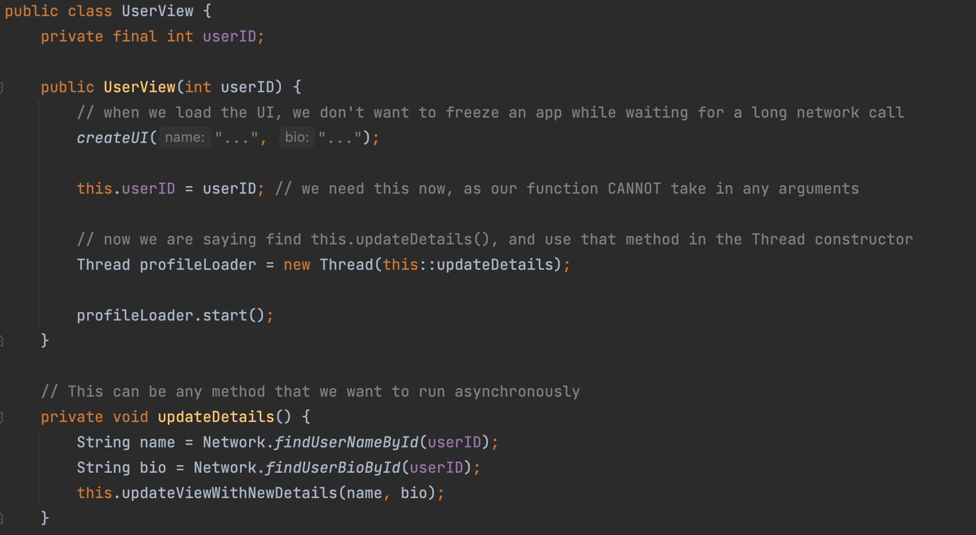
Threads for Dummies Professionals Experts
Note that this method doesn’t return anything, and has no parameters!

Slide 9
Advantages and Disadvantages
We don’t have to write a new inner class, which overrides run, and has it’s own properties when it needs to
We simply write a method as usual, and use it like so
Thread thread = new Thread(this::myMethod);
thread.start()
However, if this is confusing, don’t worry about it, but it can make threads a lot simpler to think about as they are now just methods that run in parallel

Slide 10
Source Code
The examples and a short description of method referencing can be found at:
https://github.com/jakedves/PAL-Threading-Java

Slide 11

Finding the optimal policy
Bellman Equation –
If we are following an optimal policy, the value of a state will equal the best possible expected value of the actions available at that state.
If we can solve the Bellman optimality equations, we can find an optimal deterministic policy very easily.
But, solving them isn’t so straight forward ☹
We can’t just plug in the equation and expect it to work for all states instantly
Solution?

Slide 12

Value Iteration
Bellman Equation –
Recursion
We can iteratively update the values for each state until they converge
This means we need some initial values to start with
Bellman optimality update equation -

Slide 13
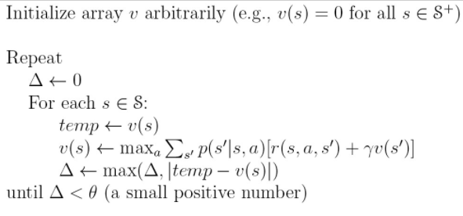
Value Iteration
Bellman Optimality Update Equation –
Initial values for each state
For each state, store the current value for that state, v(s)
Find the max value given our current values
Continuously update the max difference in each update
Check if converged (based on set threshold)

Slide 14
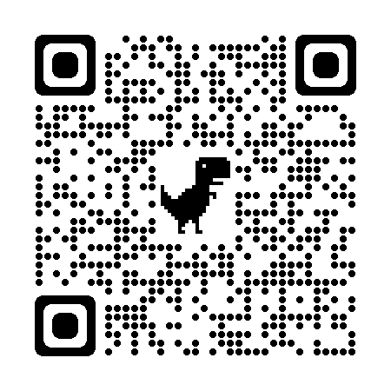
You could be a PAL Leader next year!
Lead sessions, help others, and develop valuable skills –
Communication skills.
Public speaking and presentation skills.
Teamwork and organisation.
Scan the QR code to find out more.
thesubath.com/peer-support/pal/becomeapalleader/

